Slide 1
Grid Maps for Robot Mapping

Slide 2
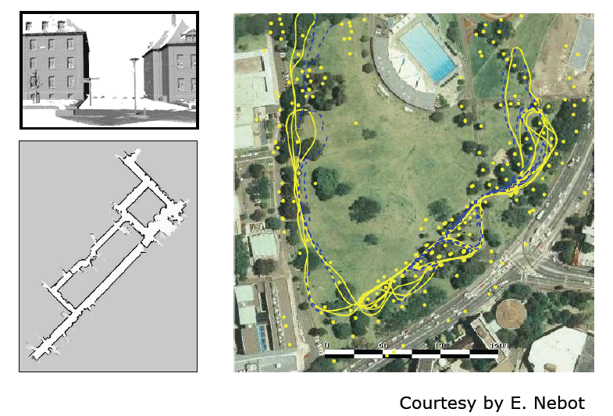
Features versus Volumetric Maps

Slide 3
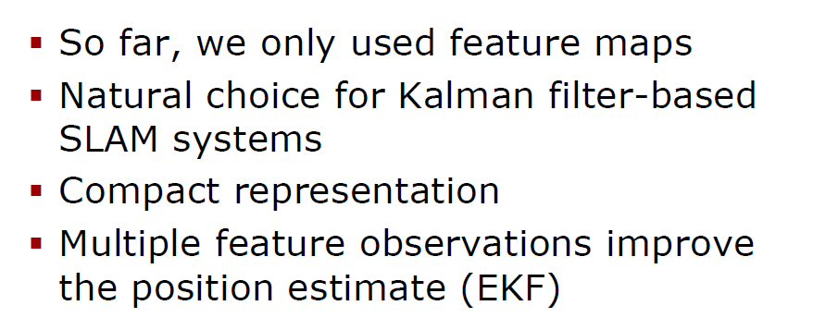
Features

Slide 4
Grid Map Representation

Slide 5
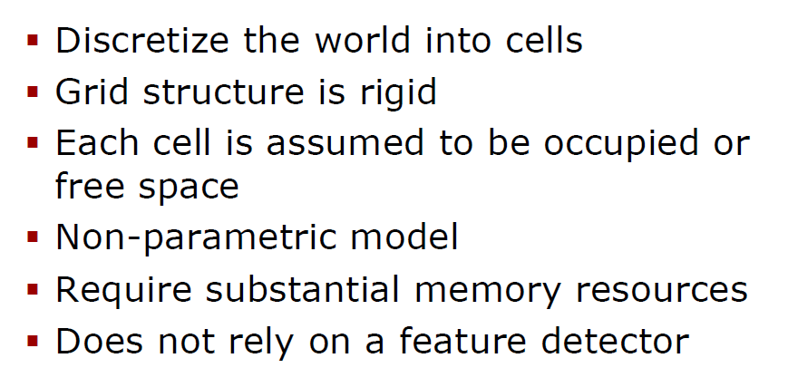
Grid Maps

Slide 6
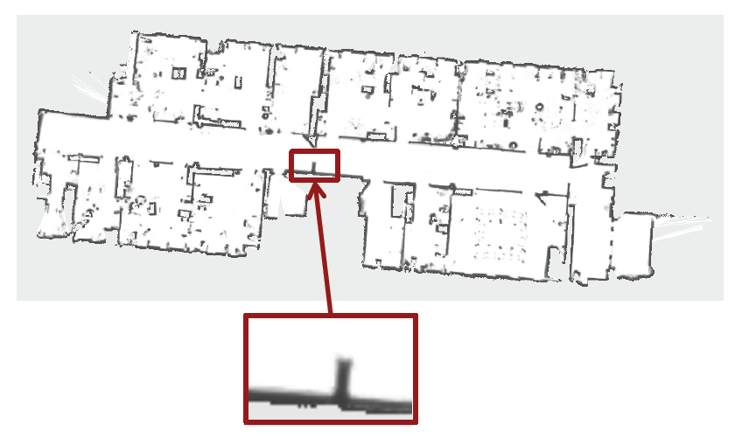
Example of Grid Map inaccuracy

Slide 7
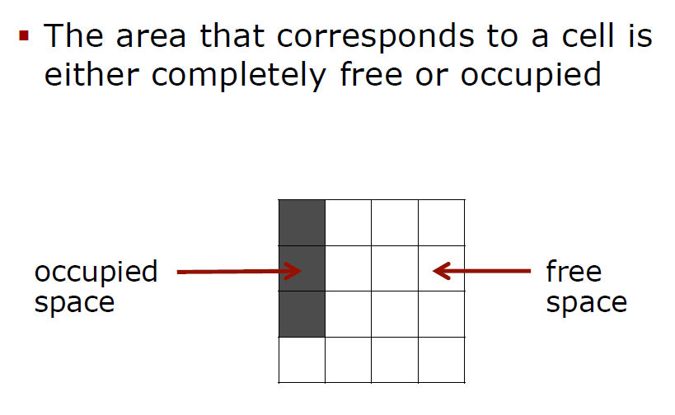
Assumption 1 for Grid Maps

Slide 8
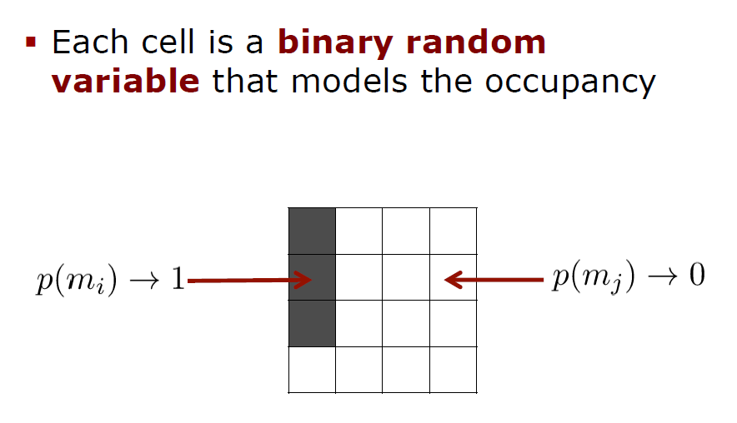
Variables for Grid Map Representation

Slide 9
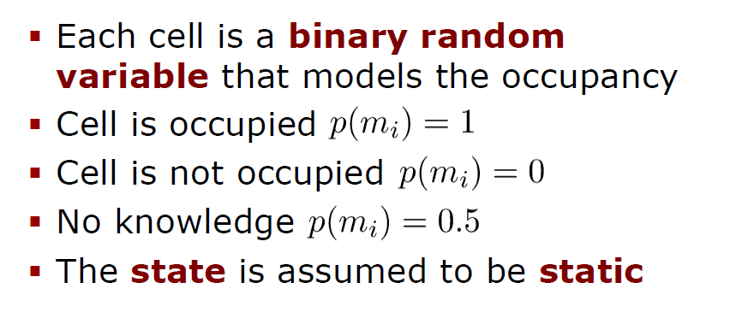
Occupancy Probability for cells in Grid Maps

Slide 10
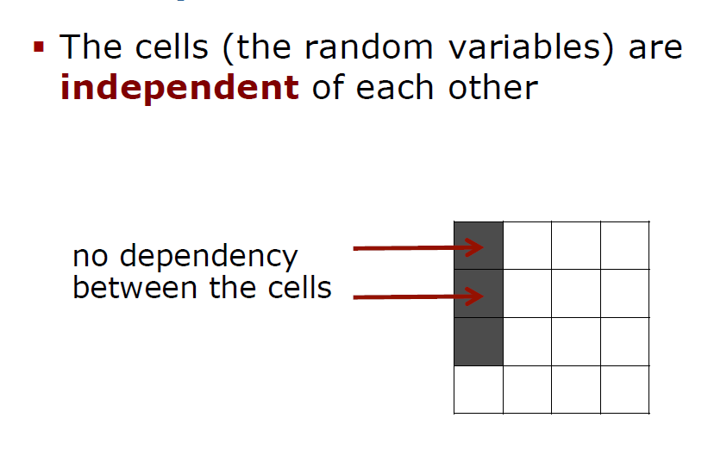
Assumption 2 for cells in Grid Maps

Slide 11
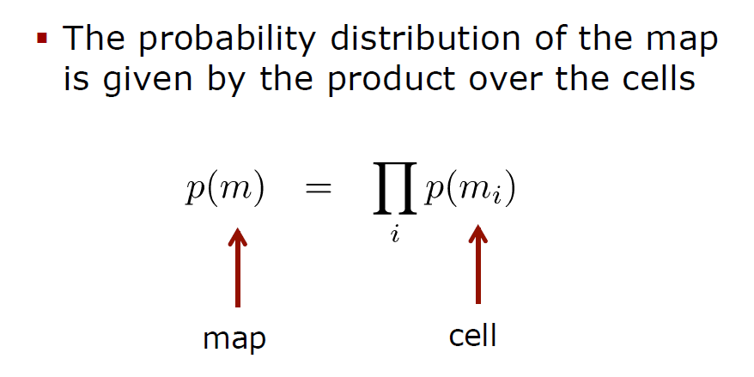
Probability of cells occupancy in Grid Maps

Slide 12
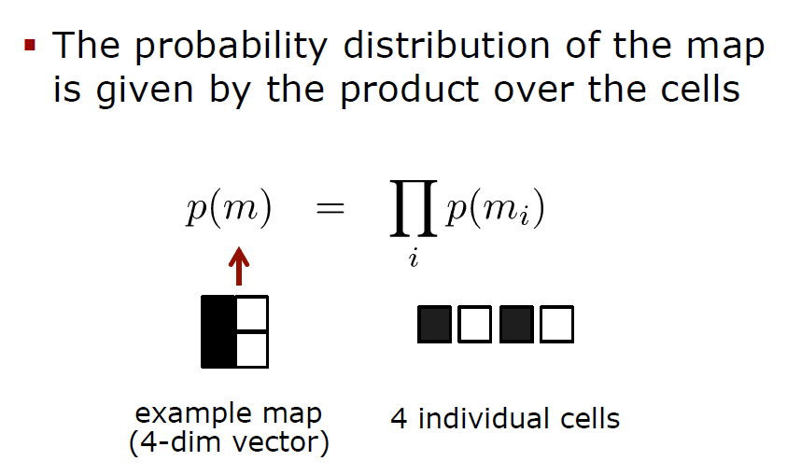
Probability distribution in Grid Maps

Slide 13
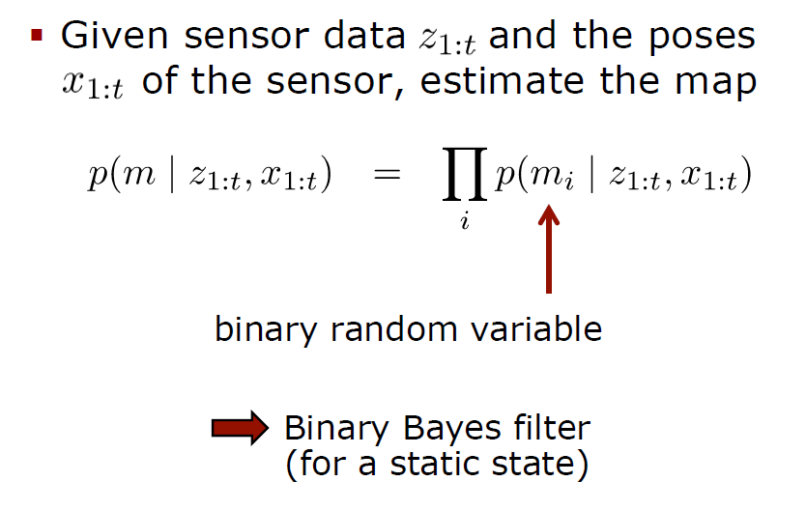
Estimating a Map from Data

Slide 14
Static State Binary Bayes Filter

Slide 15
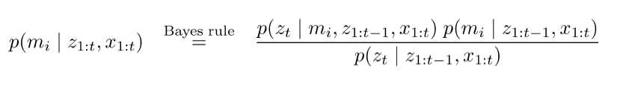
Static State Binary Bayes Filter

Slide 16
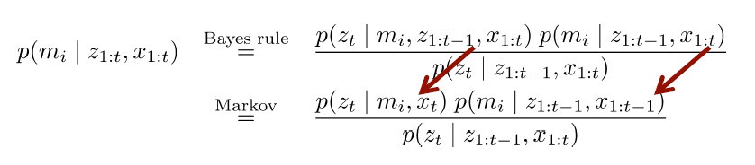
Static State Binary Bayes Filter

Slide 17
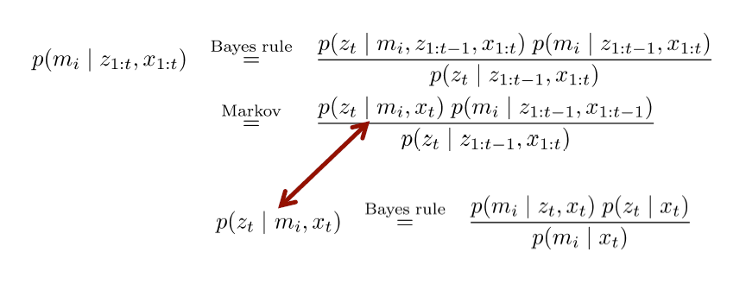
Static State Binary Bayes Filter

Slide 18
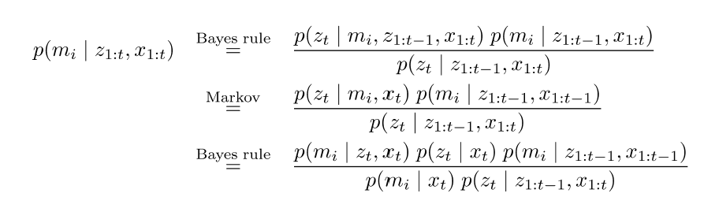
Static State Binary Bayes Filter

Slide 19
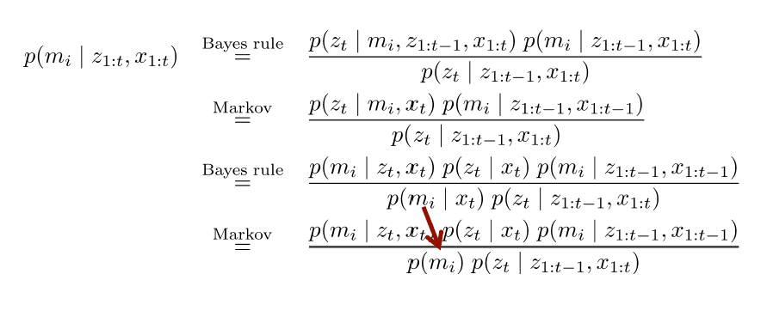
Static State Binary Bayes Filter

Slide 20
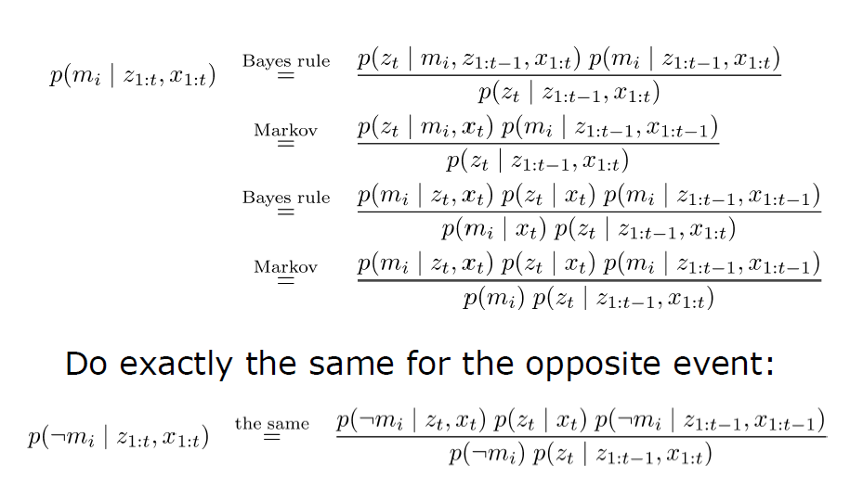
Static State Binary Bayes Filter

Slide 21
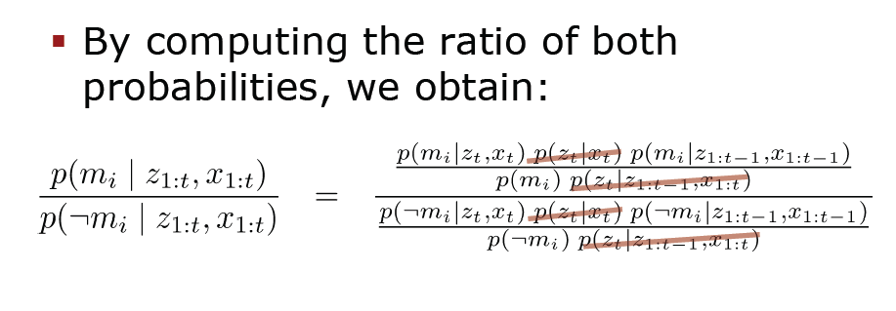
Static State Binary Bayes Filter

Slide 22
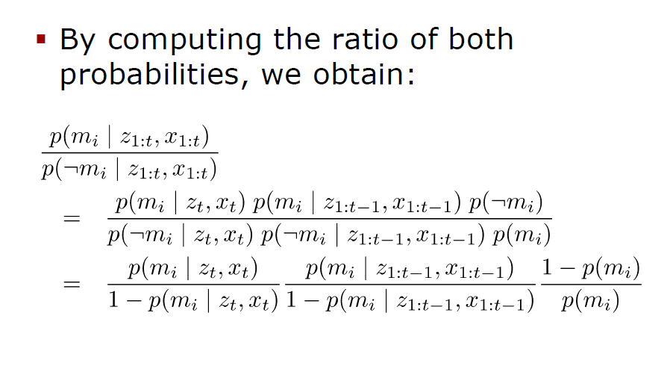
Static State Binary Bayes Filter

Slide 23
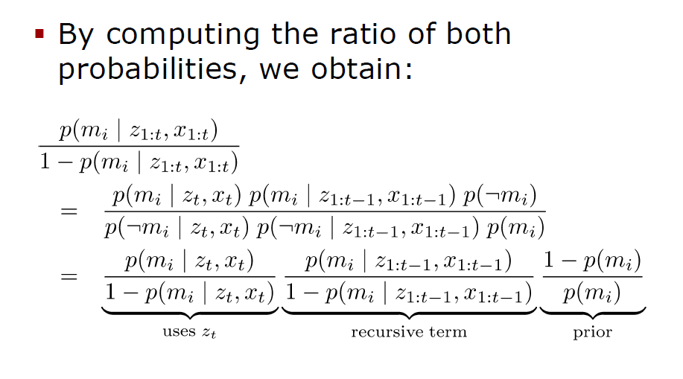
Static State Binary Bayes Filter

Slide 24
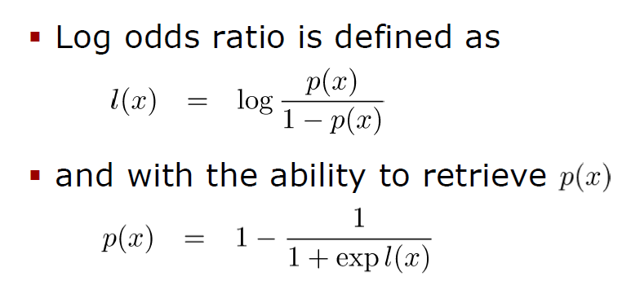
Log Odds Notation

Slide 25
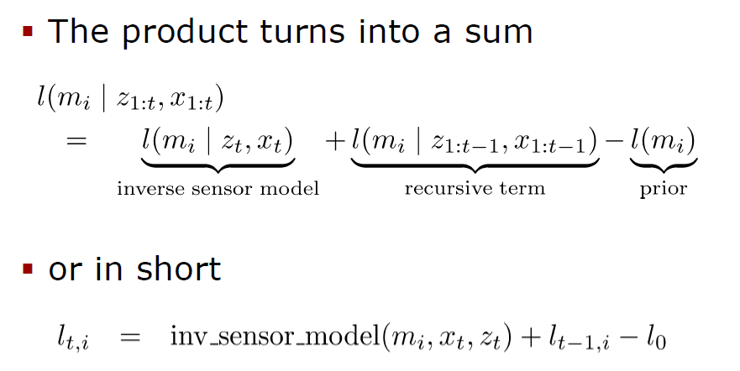
Occupancy Mapping in Log Odds Form

Slide 26
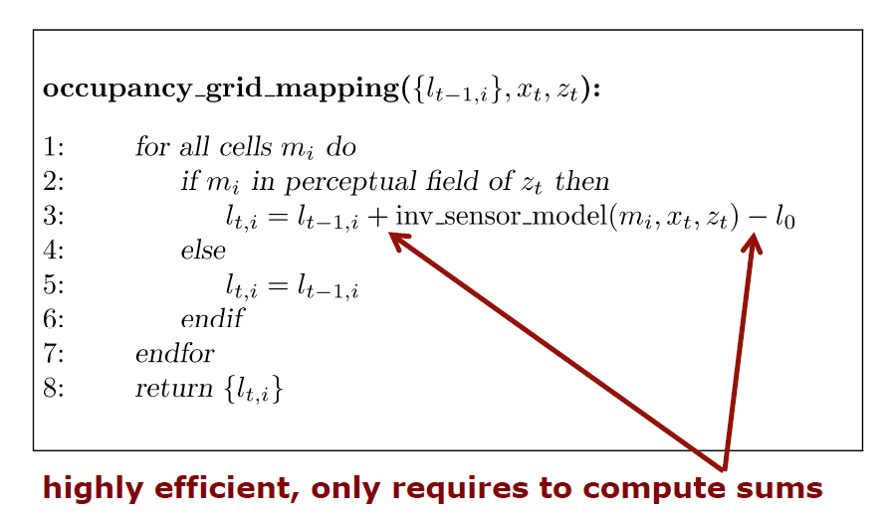
Occupancy Mapping Algorithm

Slide 27
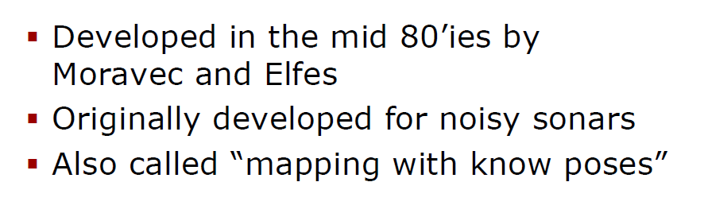
Occupancy Grid Mapping

Slide 28
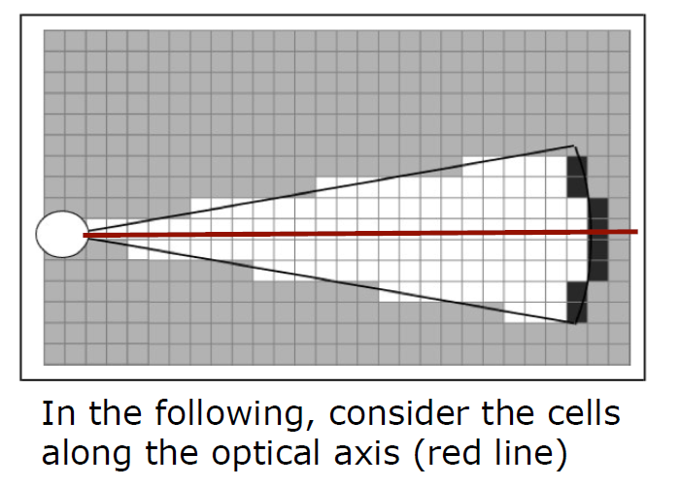
Inverse Sensor Model for Sonars Range Sensors

Slide 29
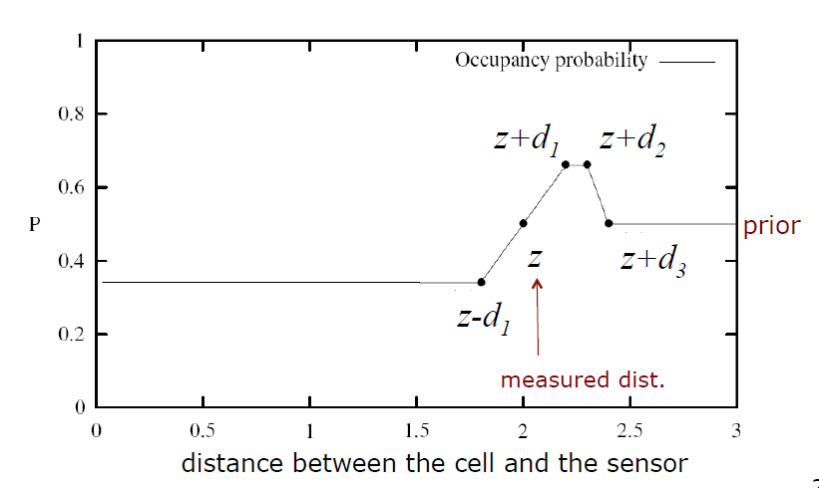
Occupancy Value Depending on the Measured Distance

Slide 30
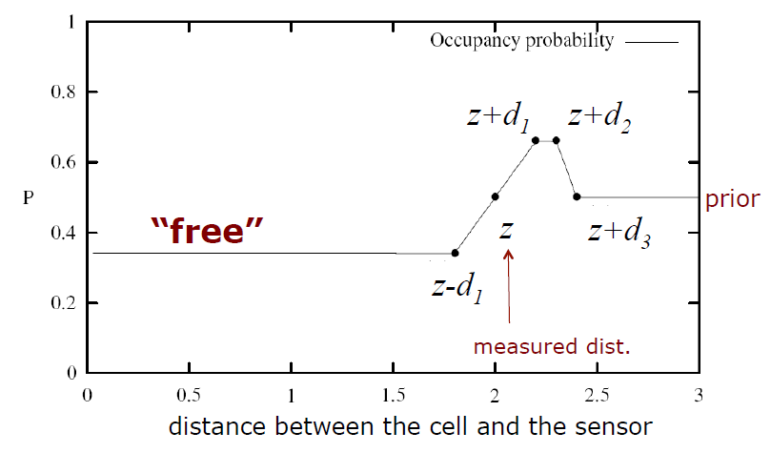
Occupancy Value Depending on the Measured Distance

Slide 31

Occupancy Value Depending on the Measured Distance

Slide 32
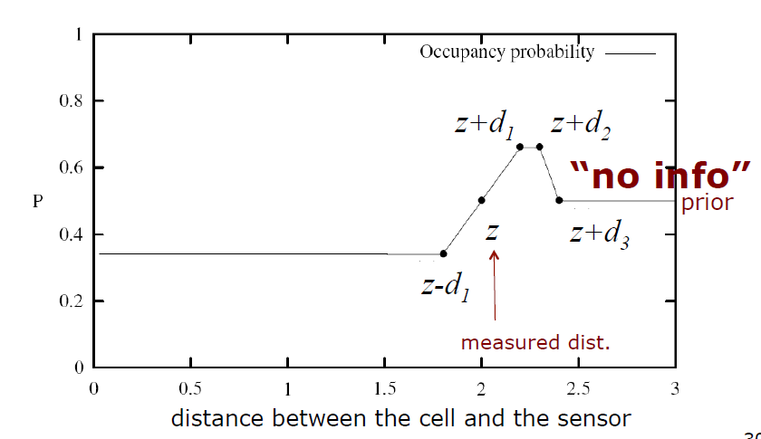
Occupancy Value Depending on the Measured Distance

Slide 33
Examples of Occupancy Grids

Slide 34
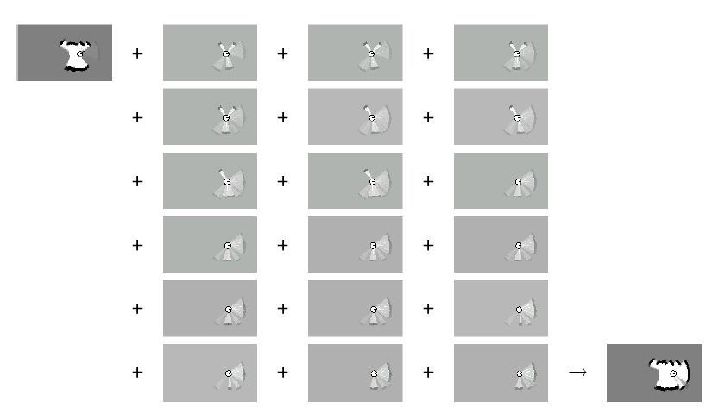
Example: Incremental Updating of Occupancy Grids

Slide 35
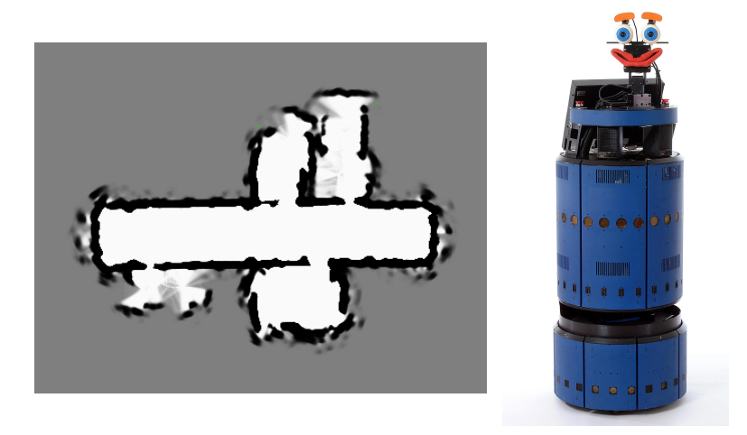
Resulting Map Obtained with Ultrasound Sensors

Slide 36
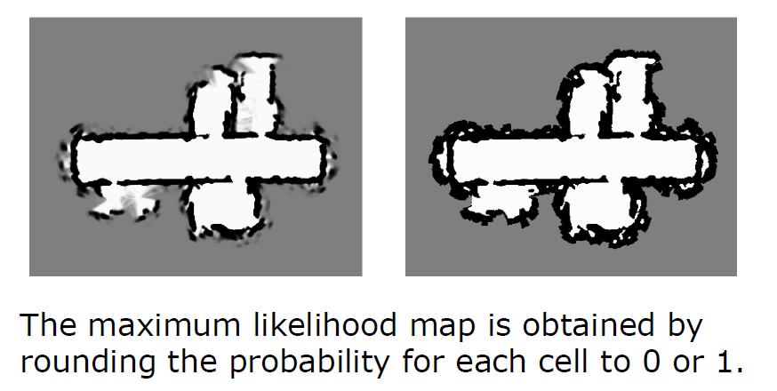
Resulting Occupancy and Maximum Likelihood Map

Slide 37
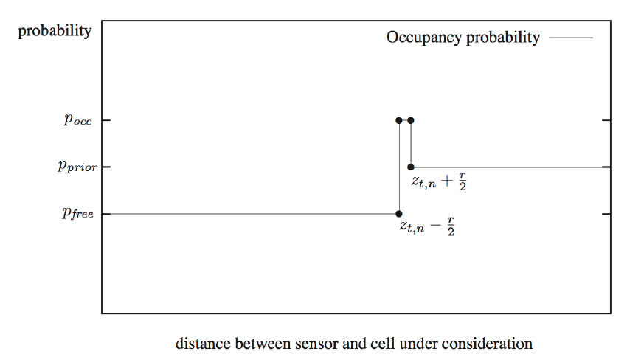
Inverse Sensor Model for Laser Range Finders

Slide 38
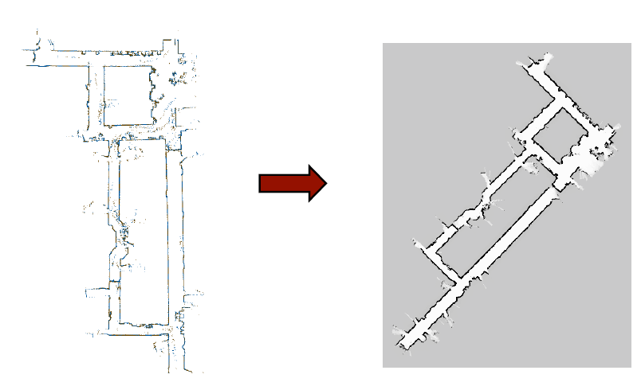
Occupancy Grids from Laser Scans to Maps

Slide 39
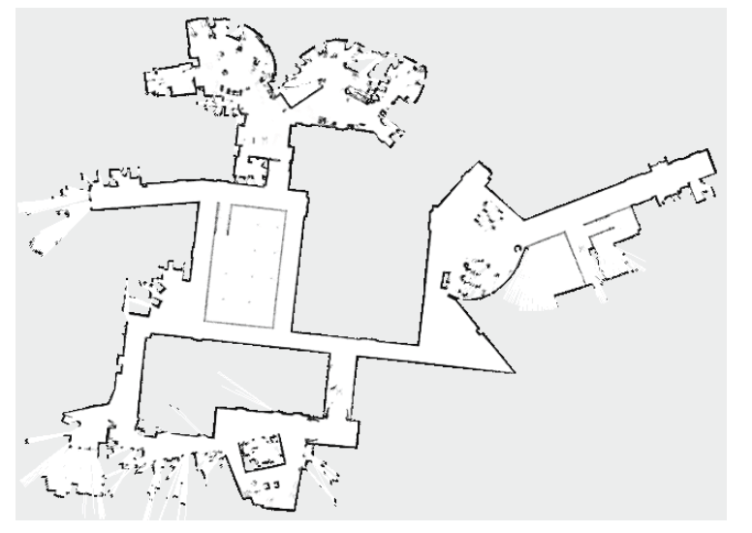
Example: MIT CSAIL 3rd Floor

Slide 40
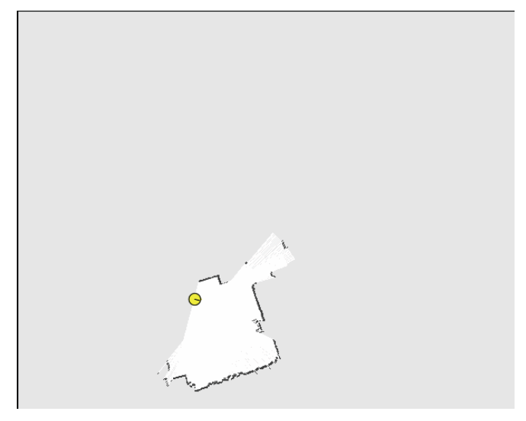
Uni Freiburg Building 106

Slide 41
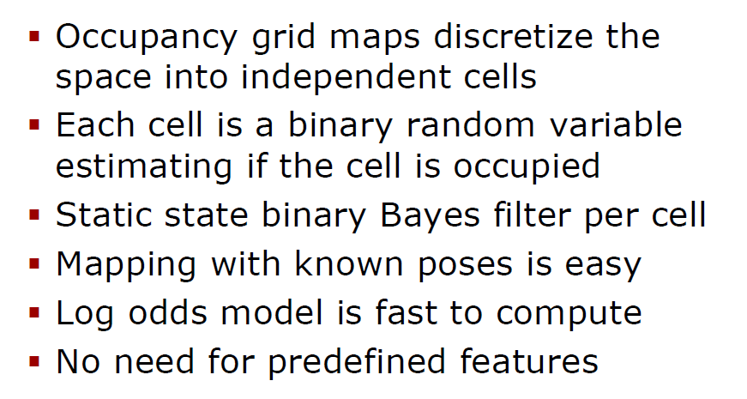
Summary

Slide 42
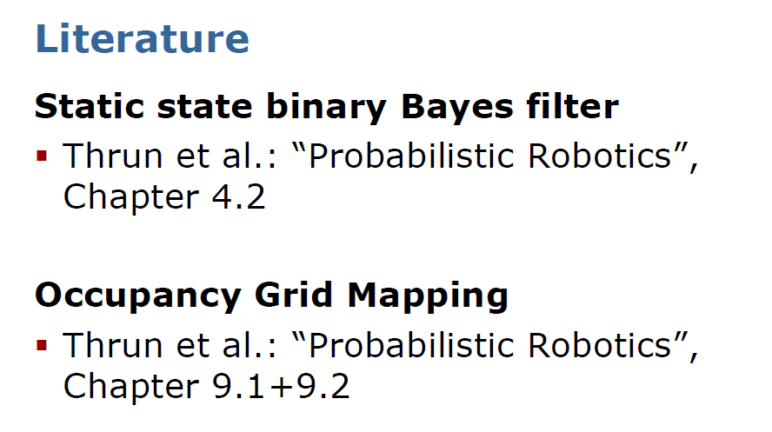

Slide 44
